Slide 1
Convolutional Neural Network, Recurrent Neural Network & Connectionist Temporal Classification
Yu Tian
School of Electronics Engineering & Computer Science
Peking University, 100871, Beijing, China
tianyu_eecs@pku.edu.cn

Slide 2
Outline
Neural Network
Back propagation
Convolution Neural Network
Recurrent Neural Network
LSTM
Connectionist Temporal Classification
Theoretical derivation and realization

Slide 3
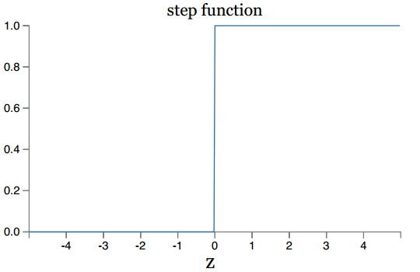
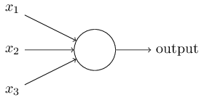
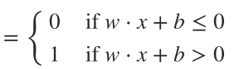
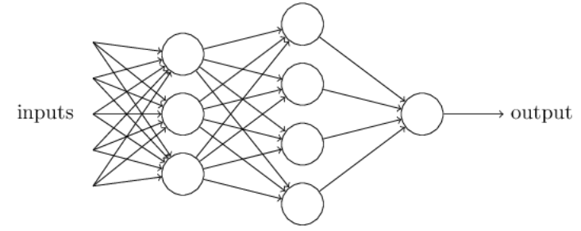
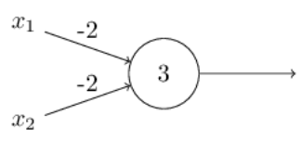
Neural Network Perceptrons
Weights: expressing the importance of the respective inputs to the output
weight
bias
Bias: measuring the degree of laziness of neurons
NAND gate
First layer is making three very simple decisions, by weighing the input evidence.
We can use networks of perceptrons to compute any logical function at all.
Second layer can make a decision at a more complex and more abstract level
Notes:
second layer is making a decision by weighing up the results from the first layer

Slide 4
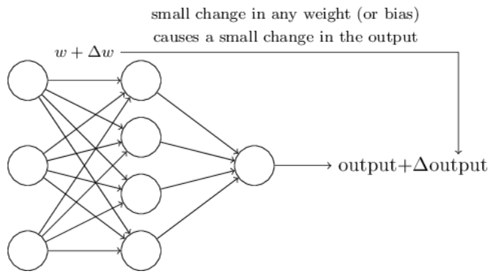
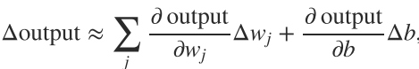
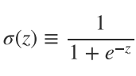
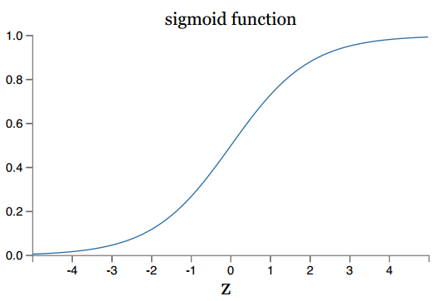
Neural Network The key to learning - Sigmoid Neural
Small change in weight to cause only a small corresponding change in the output from the network.
Smoothness differentiable
This linearity makes it easy to choose small changes in the weights and biases to achieve any desired small change in the output.
Output of sigmoid neuron represents the log odds of whether or not a feature is detected.
Notes:
需要输出必须连续的，可导，可微的。
泰勒展开

Slide 5
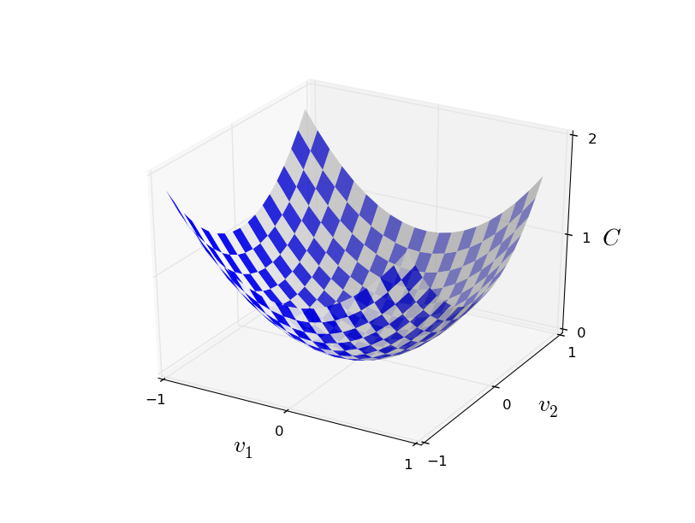
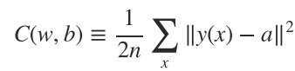
Neural Network The key to learning – Loss Function
Requirement
Quantify how well we're learning
Positive
Is a smooth function of the weights and biases in the network
Can be written as a function of the outputs from the neural network
Can be written as an average over cost functions for individual training examples
Required by BP
Notes:
损失函数必须为正的
a为期望输出
损失函数在局部一定为凸函数。

Slide 6
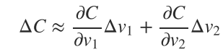
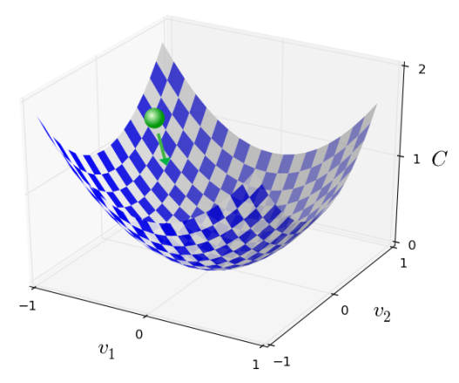
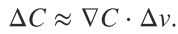
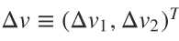
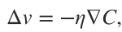
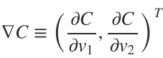
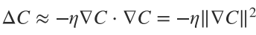
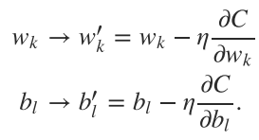
Neural Network Gradient Descent
C will always decrease never increase.
Notes:
In practice, to compute the gradient ∇C∇C we need to compute the gradients ∇Cx∇Cx separately for each training input, xx, and then average them, ∇C=1n∑x∇Cx∇C=1n∑x∇Cx. Unfortunately, when the number of training inputs is very large this can take a long time, and learning thus occurs slowly.
An idea called stochastic gradient descent can be used to speed up learning. The idea is to estimate the gradient ∇C∇C by computing ∇Cx∇Cx for a small sample of randomly chosen training inputs. By averaging over this small sample it turns out that we can quickly get a good estimate of the true gradient ∇C∇C, and this helps speed up gradient descent, and thus learning.
Of course, the estimate won't be perfect - there will be statistical fluctuations - but it doesn't need to be perfect: all we really care about is moving in a general direction that will help decrease CC, and that means we don't need an exact computation of the gradient.

Slide 7
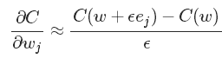
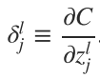
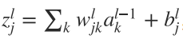
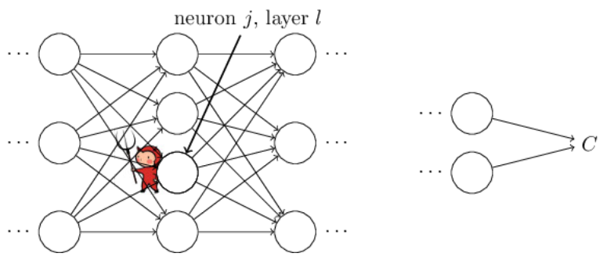
Neural Network Back Propagation (BP) algorithm
Too Complicated
The back propagation provide us with a way of computing the gradient of the cost function. compute all the partial derivatives using just one forward pass through the network, followed by one backward pass through the network.
Error Signal
Weighted input
Perspective One
is a measure of the error in the neuron.
最优点偏导数应该为0
Perspective Two
Dynamic programing-Computation efficient

Slide 8
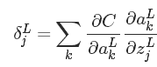
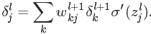
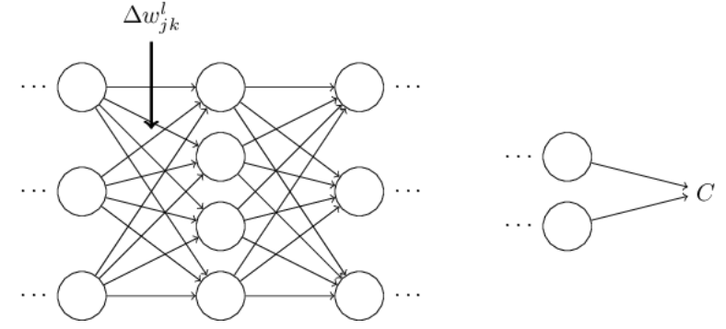
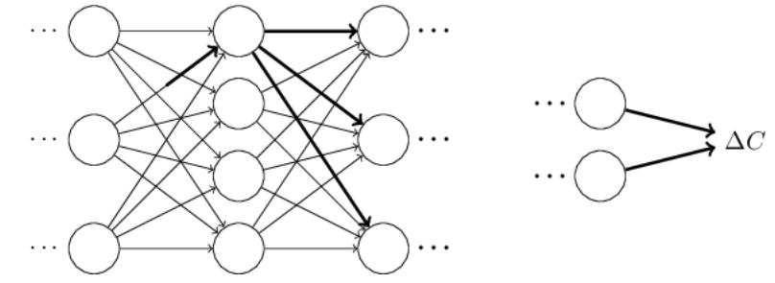
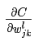
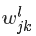
Neural Network Error Signal
Output layer
Weighted input
Activation
Hidden layer
Weighted input
Activation
Error of last layer
What's BP really doing
Computing is to carefully track how a small change in propagates to cause a small change in C.

Slide 9
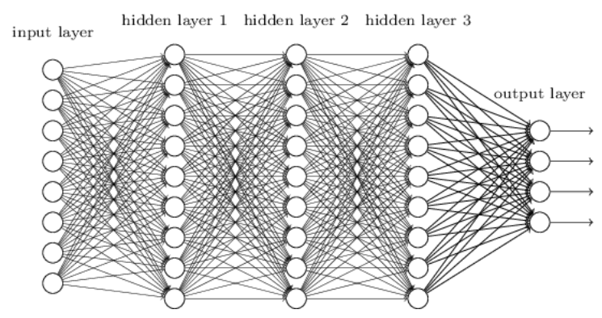
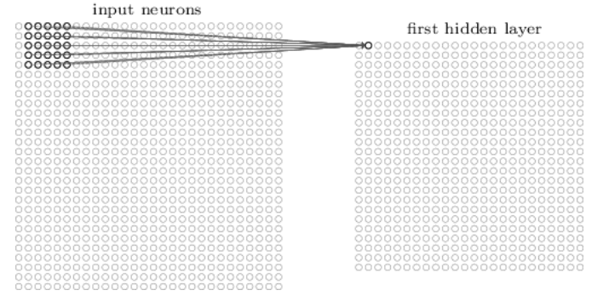
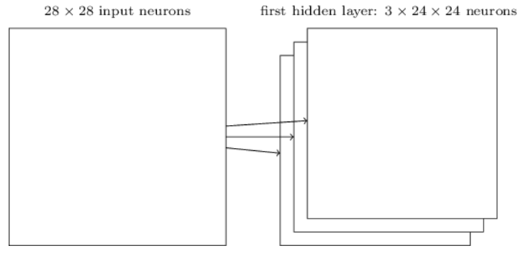
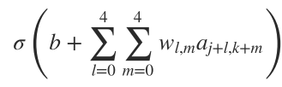
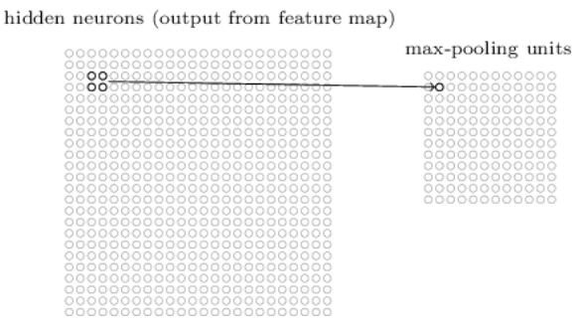
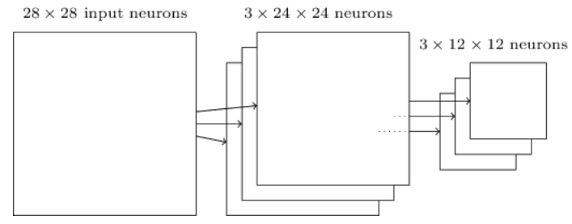
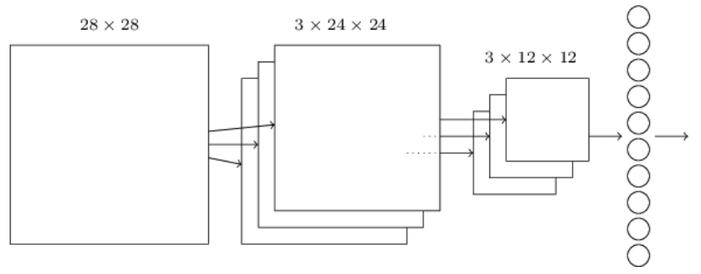
Convolutional Neural Network architecture
Local receptive Fields and convolution
Pooling layer
One Layer CNN

Slide 10
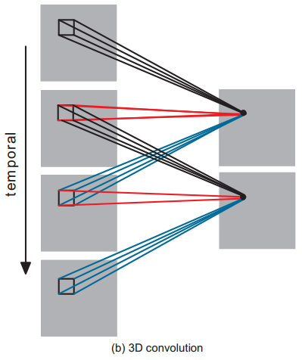
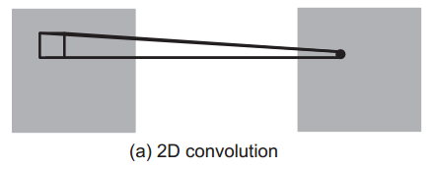
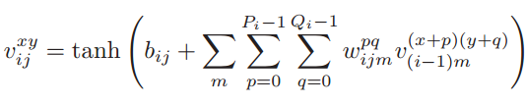
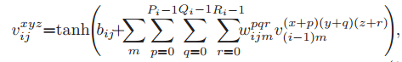
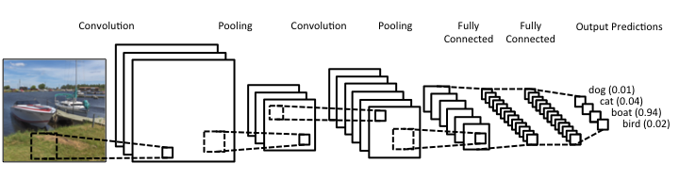
Convolutional Neural Network 2D CNN & 3D CNN & Deep CNN

Slide 11
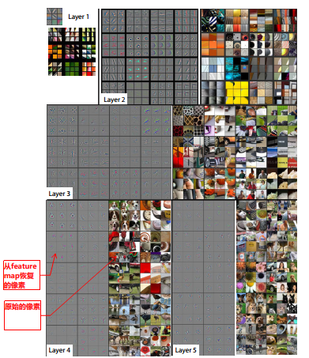
The strong grouping within each feature map
The projections from each layer show the hierarchical nature of the features in the network.
Layer 2 responds to corners and other edge/color conjunctions.
Layer 3 has more complex invariances, capturing similar textures (e.g. mesh patterns (Row 1, Col 1); text (R2,C4)).
Layer 4 shows significant variation, and is more class-specific: dog faces (R1,C1); bird’s legs (R4,C2).
Layer 5 shows entire objects with significant pose variation, e.g. keyboards (R1,C11) and dogs (R4).
层次性
Notes:
early layers answering very simple and specific questions about the input image, and later layers building up a hierarchy of ever more complex and abstract concepts. Networks with this kind of many-layer structure - two or more hidden layers - are called deep neural networks.

Slide 12
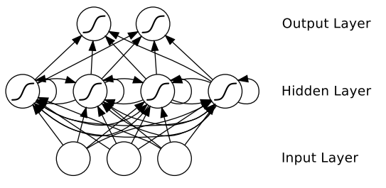
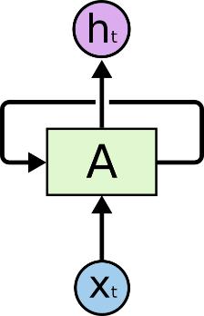
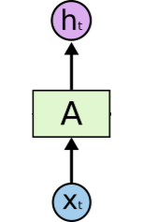

Recurrent Neural Network (RNN) Architecture
RNN
Feedforward Neural Network (FNN)
Unfolding: A recurrent neural network can be thought of as multiple copies of the same network, each passing a message to a successor. Consider what happens if we unroll the loop.
RNN not only operate on an input space but also on an internal state space – a trace of what already has been processed by the network.
Hammer, 2000 : RNN with a sufficient number of hidden units can approximate any measurable sequence-to-sequence mapping to arbitrary accuracy.
Notes:
enables the representation (and learning) of temporally/sequentially extended dependencies over unspecified (and potentially infinite) intervals
状态空间使得能够在任意间隔上表示时间上的依赖关系

Slide 13
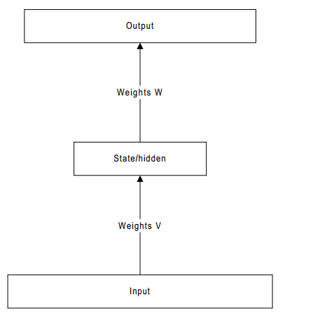
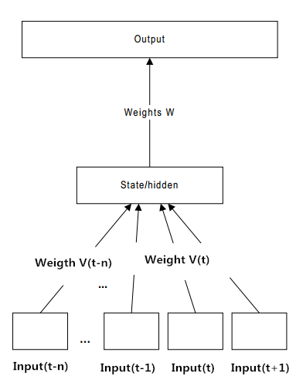
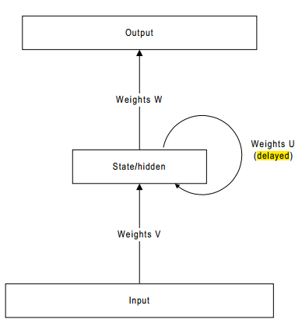
Benefits of RNN over Tapped Delay Line
The easiest way to incorporate temporal or sequential information is to make the temporal domain spatial and use a feedforward architecture.
feedforward
tapped delay line
RNN
Disadvantages: the user has to select the maximum number of time steps which is useful to the network.
In addition, the large number of weights requires a larger set of examples to avoid over-specialization.

Slide 14
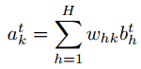
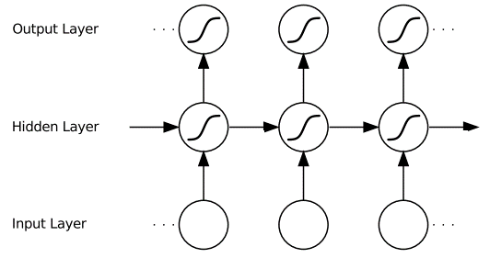


RNN Implementation – forward pass
X_{i(j)}
X_{i(j+1)}
X_{i(j+2)}
t=0
t=T
Same weights are reused at every timestep
Notes:
An unfolded recurrent network. Each node represents a layer of network units at a single timestep. The weighted connections from the input layer to hidden layer are labelled ‘w1’, those from the hidden layer to itself (i.e. the recurrent weights) are labelled ‘w2’ and the hidden to output weights are labelled ‘w3’. Note that the same weights are reused at every timestep. Bias weights are omitted for clarity
The complete sequence of hidden activations can be calculated by starting at t = 1 and recursively applying (3.30) and (3.31), incrementing t at each step.

Slide 15




RNN Implementation – backward pass
Error signal
x_{i}
x_{i}
x_{i}
t=0
t=T
Notes:
Finally, bearing in mind that the same weights are reused at every timestep, we sum over the whole sequence to get the derivatives with respect to the network weights

Slide 16

RNN Implementation – backward pass Other perspectives
Perspective One
不同timestep的输入可以看成不同维度。
最终权重的更新要考虑所有维度要求下降的梯度。
Perspective Two
隐藏层之间的连接刻画了状态转移的规则。
Notes:
此图为最后时刻的传递过程。

Slide 17



Bidirectional RNN (BRNN)
Standard RNNs process sequences in temporal order, they ignore future context.
BRNN present each training sequence forwards and backwards to two separate recurrent hidden layers, both of which are connected to the same output layer.

Slide 18






RNN - Vanishing Gradient Problem
Notes:
小数据量，不适合使用relu，可以使用sigmoid或者tanh。

Slide 19

RNN – Not suitable for long term dependence
Reason one: The gradient is decaying. Therefore long term input can long used for training the network. As a result, RNN can not learn long term dependence.
Reason two: he sensitivity decays over time as new inputs overwrite the activations of the hidden layer, and the network ‘forgets’ the first inputs.

Slide 20




Long Short Temporal Memory (LSTM)
LSTMs were designed to combat vanishing gradients through a gating mechanism.
Conventional RNN
LSTM
The key to LSTMs is the cell state, the horizontal line running through the top of the diagram.
Elementwise Multiplying
The LSTM does have the ability to remove or add information to the cell state, carefully regulated by structures called gates.
The sigmoid layer outputs numbers between zero and one, describing how much of each component should be let through.
Notes:
They care called gates because the sigmoid function squashes the values of these vectors between 0 and 1, and by multiplying them elementwise with another vector you define how much of that other vector you want to “let through”. The input gate defines how much of the newly computed state for the current input you want to let through. The forget gate defines how much of the previous state you want to let through. Finally, The output gate defines how much of the internal state you want to expose to the external network (higher layers and the next time step). All the gates have the same dimensions , the size of your hidden state.
g is a “candidate” hidden state that is computed based on the current input and the previous hidden state.
However, instead of taking as the new hidden state as we did in the RNN, we will use the input gate from above to pick some of it.
is the internal memory of the unit. It is a combination of the previous memory multiplied by the forget gate, and the newly computed hidden state , multiplied by the input gate. Thus, intuitively it is a combination of how we want to combine previous memory and the new input. We could choose to ignore the old memory completely (forget gate all 0’s) or ignore the newly computed state completely (input gate all 0’s), but most likely we want something in between these two extremes.

Slide 21


Forward of LSTM
Step1： Decide what information we’re going to throw away from the cell state.
Step2： Decide what new information we’re going to store in the cell state.
Notes:
The first step in our LSTM is to decide what information we’re going to throw away from the cell state. This decision is made by a sigmoid layer called the “forget gate layer.” It looks at ht−1ht−1 and xtxt, and outputs a number between 00 and 11 for each number in the cell state Ct−1Ct−1. A 11represents “completely keep this” while a 00 represents “completely get rid of this.”
The next step is to decide what new information we’re going to store in the cell state. This has two parts. First, a sigmoid layer called the “input gate layer” decides which values we’ll update. Next, a tanh layer creates a vector of new candidate values, C~tC~t, that could be added to the state. In the next step, we’ll combine these two to create an update to the state.

Slide 22


Forward of LSTM
Step3： Update the old cell state.
Step4： Decide what we’re going to output

Slide 23


backward of LSTM reverse the arrow
f
h
f
f
g
Notes:
反向传播 逆着箭头走

Slide 24






Why LSTM can handle long term dependence Reason 1: Combat gradient vanishing
Conventional RNN
LSTM

Slide 25

Why LSTM can handle long term dependence Reason 2: Combat activation overwrite
The memory cell ‘remembers’ the first input as long as the forget gate is open and the input gate is closed. The sensitivity of the output layer can be switched on and off by the output gate without affecting the cell.
Notes:
如果使用LSTM处理短时序的问题，因为数据量少，容易造成过拟合。

Slide 26



Variation of LSTM
Peephole Connections
Coupled Gates
GRU
Notes:
This means that we let the gate layers look at the cell state.
Another variation is to use coupled forget and input gates. Instead of separately deciding what to forget and what we should add new information to, we make those decisions together. We only forget when we’re going to input something in its place. We only input new values to the state when we forget something older.
A slightly more dramatic variation on the LSTM is the Gated Recurrent Unit, or GRU, introduced by Cho, et al. (2014). It combines the forget and input gates into a single “update gate.” It also merges the cell state and hidden state, and makes some other changes. The resulting model is simpler than standard LSTM models, and has been growing increasingly popular.
LSTM: A Search Space Odyssey https://arxiv.org/pdf/1503.04069.pdf

Slide 27









Extensions of RNN – Attention focusing on part of a subset of the information they’re given at different step
Neural Turing Machines (NTM)
Combine a RNN with an external memory bank.
Every step, read and write every memory to different extents.
Read
Write
Notes:
https://distill.pub/2016/augmented-rnns/
网络能学习，必须是可微的。
Instead of specifying a single location, the RNN outputs an “attention distribution” that describes how we spread out the amount we care about different memory positions. As such, the result of the read operation is a weighted sum.
Similarly, we write everywhere at once to different extents. Again, an attention distribution describes how much we write at every location. We do this by having the new value of a position in memory be a convex combination of the old memory content and the write value, with the position between the two decided by the attention weight.

Slide 28



Extensions of RNN – Attention focusing on part of a subset of the information they’re given at different step
Attention Interface
Interaction Interface between Neural Network A with Neural Network B
RNN + Attention + RNN
for voice recognition
CNN + Attention + RNN
for image description
Notes:
using attention, focusing on part of a subset of the information they’re given.
For example, an RNN can attend over the output of another RNN. At every time step, it focuses on different positions in the other RNN.
We’d like attention to be differentiable, so that we can learn where to focus. To do this, we use the same trick Neural Turing Machines use: we focus everywhere, just to different extents.
It can be used in voice recognition [12], allowing one RNN to process the audio and then have another RNN skim over it, focusing on relevant parts as it generates a transcript.
This allows the RNN to look at different position of an image every step. One popular use of this kind of attention is for image captioning. First, a conv net processes the image, extracting high-level features. Then an RNN runs, generating a description of the image. As it generates each word in the description, the RNN focuses on the conv net’s interpretation of the relevant parts of the image.

Slide 29


Extensions of RNN – Attention focusing on part of a subset of the information they’re given at different step
Adaptive Computation Time
Different amounts of computation in each time step
Allow the RNN to do multiple steps of computation for each time step
Implementation
Notes:
In order for the network to learn how many steps to do, we want the number of steps to be differentiable. We achieve this with the same trick we used before: instead of deciding to run for a discrete number of steps, we have an attention distribution over the number of steps to run. The output is a weighted combination of the outputs of each step.

Slide 30

Extensions of RNN – Attention focusing on part of a subset of the information they’re given at different step
Neural Programmer
Notes:
The generated program is a sequence of operations. Each operation is defined to operate on the output of past operations.
At each step, the controller RNN outputs a probability distribution for what the next operation should be.
The resulting distribution over operations can now be evaluated. Instead of running a single operation at each step, we do the usual attention trick of running all of them and then average the outputs together, weighted by the probability we ran that operation.

Slide 31



Connectionist temporal classification (CTC) output layer for recurrent neural networks
The goal of sequence labelling is to assign sequences of labels, drawn from a fixed alphabet, to sequences of input data.
Three levels of sequence labelling
locations of the target labels are unknown
RNN + Markov or RNN + CTC
locations of the target labels are known in advance
Context aids inferring
the label sequences are constrained to be length 1
standard pattern classification
Output: Logistic sigmoid output (two classes) and softmax output (multiple classes)
Classification targets typically presented at the ends of the sequences or segments.
Loss functions: based on maximum-likelihood
z_{k} is one-hot
Notes:
Sequence Classification : If the input sequences are of fixed length, or can be easily padded to a fixed length, they can be collapsed into a single input vector and any of the standard pattern classification algorithms mentioned in Section 2.2 can be applied.
However, even if the input length is fixed, algorithm that are inherently sequential may be beneficial, since they are better able to adapt to translations and distortions in the input data. 可以更好地提取更为鲁棒的特征
A crucial element of segment classification, missing from sequence classification, is the use of context information from either side of the segments to be classified. The effective use of context is vital to the success of segment classification algorithms.可以根据上下文的依赖关系辅助判断

Slide 32
Connectionist temporal classification (CTC) output
Assume that the labels are drawn from an alphabet A,CTC consists of a softmax output layer with one more unit than there are labels in A (blank label or no label).
Labelling distribution
The activation vector is the probabilities of the corresponding labels occur at particular times.
activation vectors
softmax
softmax
softmax
The complete sequence of network outputs vector is then used to define a distribution over all possible label sequences of length up to that of the input sequence.
Notation
label: element in A’ (A + blank label)
labelling/label sequence: sequence of labels
RNN

Slide 33

Connectionist temporal classification (CTC) path & labelling
由于被打断/动作持续时间不同, 同一个labelling可能有不同的表现形式.
这些不同的表现形式导致的不同network output 称为路径path
因此CTC允许同时对不同label之间、非空label与空label之间、相同label之间的转换过程进行建模。
it allows the network to predict the labels without knowing in advance where they occur.
Map paths (π) to labellings (I)
Together, these outputs define the probabilities of all possible ways of aligning all possible label sequences with the input sequence. Given input sequence x, the possibility of labelling I is given by
Notes:
由于被打断/动作持续时间不同, 同一个labelling可能有不同的表现形式

Slide 34



Connectionist temporal classification (CTC) Critical Assumption of p(π|x)
Assume the output probabilities at each timestep to be independent of those at other timesteps
对这一假设的三种理解
网络在t时刻的输出，
即估计的在t时刻出现label π_{t} 概率
This is ensured by requiring that no feedback connections exist from the output layer to itself or the network.

Slide 35
CTC - Forward-Backward Algorithm modify label sequence to traverse all possible paths
Modified label sequence I’, with blanks added to the beginning and the end of l, and inserted between every pair of consecutive labels. If the length of l is U, the length of I’ is therefore U’= 2U + 1.
Example: I = { c a t }, I’ = { - c – a – t - }, -stands for blank label.
Purpose: In calculating the probabilities of prefixes of l’ we allow all transitions between blank and non-blank labels, those between any pair of distinct non-blank labels, and stay on the same label.

Slide 36




CTC - Forward-Backward Algorithm Forward variable A Dynamic Programming Perspective
Definition: α(t,u) is the summed probability of all length t paths that (a) are mapped by F onto the length u/2 prefix of l, (b) reach the u-th state in I’.
Timestep index of path
Index of state in I’
t=T
p(t, I_{1:u/2}|x)=a(t, u)+a(t, u-1)
Iteration rules
Transfer probability
Transferred from where

Slide 37



CTC - Forward-Backward Algorithm Forward variable A Dynamic Programming Perspective
Boundary conditions
间插blank后labelling的总长度
剩余时间内最多可跨越的label个数
最乐观情况一个timestep跨过两个状态
最后一个label是blank可以不经历
在timestep t时，至少需要经历的label个数

Slide 38






CTC - Forward-Backward Algorithm backward variable
Definition: The backward variables β(t, u) are defined as the summed probabilities of all paths starting at t + 1 that complete l when appended to any path contributing to α(t, u).
Iteration rules
Boundary conditions
最多可跨越的label个数
最乐观情况一个timestep跨过两个状态

Slide 39




CTC - Forward-Backward Algorithm loss function
Definition: Loss function is defined as the negative log probability of correctly labelling all the training examples in some training set S
This is the portion of the total probability p(z|x) due to those paths going through z_{u} ’ at timestep t. For any t, we can therefore sum over all u to get

Slide 40







CTC loss gradient
Noting that the same label (or blank) may occur several times in a single labelling
Error signal

Slide 41



CTC - Decoding Best Path Decoding
Once the network is trained, we would ideally label some unknown input sequence x by choosing the most probable labelling l*
The computation complexity is too high to enumerate all possible I.
Best Path Decoding: the most probable path corresponds to the most probable labelling
Another perspective
从单个时刻看A确实出现的概率较小 倾向于没有出现。但是结合上下文的模式分布来看 更倾向于A出现了。因为一个手势出现以前往往伴随着一些准备动作 而这些准备动作可以帮助判断A是否出现 Best Path Decoding 没有利用到这些上下文信息。

Slide 42



CTC - Decoding Prefix Search Decoding
γ(p_{n}, t) be the probability of the network outputting prefix p by time t such that a non-blank label is output at t.
γ(p_{b}, t) be the probability of the network outputting prefix p by time t such that the blank label is output at t.
p(p|x) 表示p为完整labelling的概率
p(p...|x)表示p仅为prefix的概率

